Slide 1
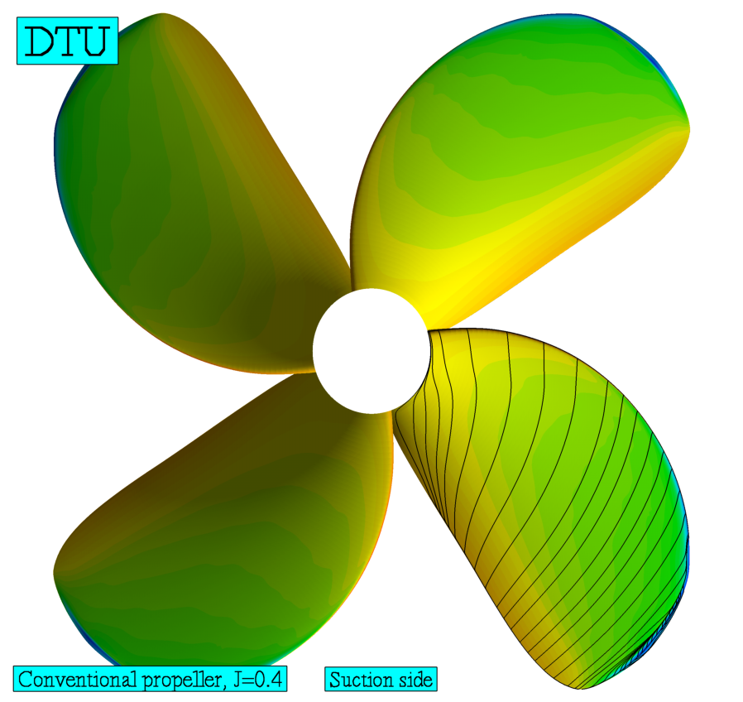
Geometri af Vindmølle rotor og Skibspropeller
Indhold
Flow gennem rotorer
Hastigheds trekanter
Skibs propeller blad
Vindmølle blad
Af: Robert Mikkelsen
Technical University of Denmark

Slide 2
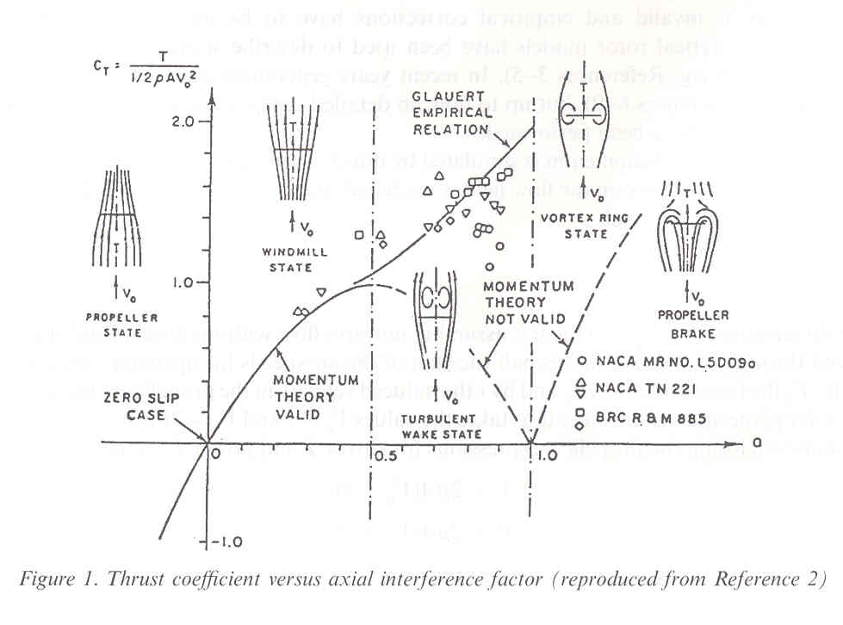
Wake states – Navier Stokes – Actuator Disc
Propeller : C_{T}= 3
Turbine : C_{T}= -0.8
Turbulent – Vortex
ring state : C_{T}= -1.3
Technical University of Denmark

Slide 3
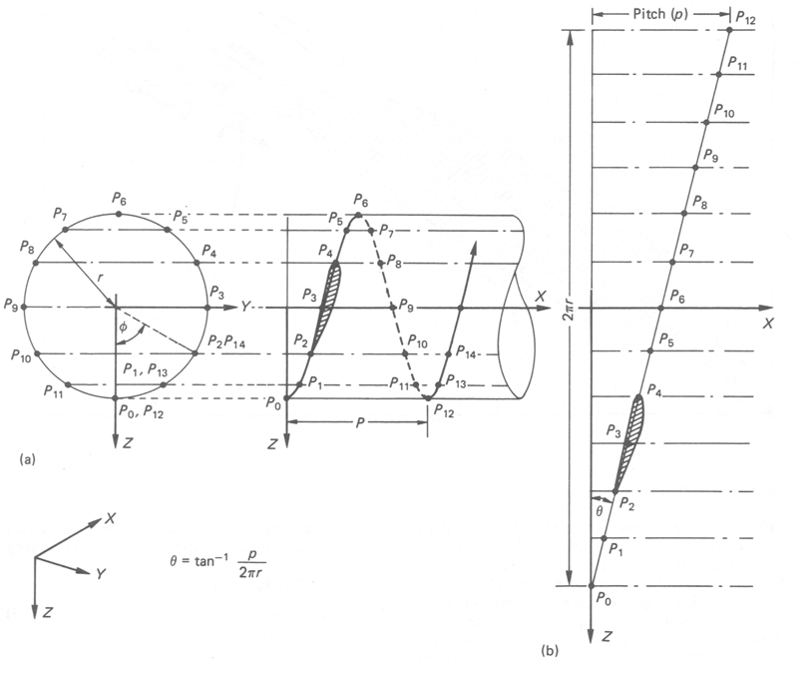
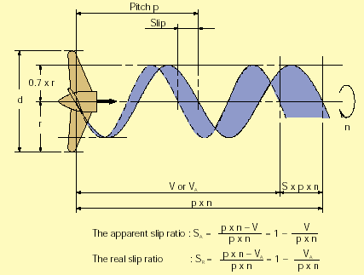
Propeller skrue – Pitch - Stigning
International Towing Tank Committee (ITTC)
Technical University of Denmark

Slide 4
Hastigheds Trekant for Propeller Rotor
φ₁
V_{rel}
w
L
F_{ax}
V_{o}+w_{ax}
φ
Pitch
V_{o}
F_{tan}
φ
Rotorplan
Ωr
w_{t}
Technical University of Denmark

Slide 5
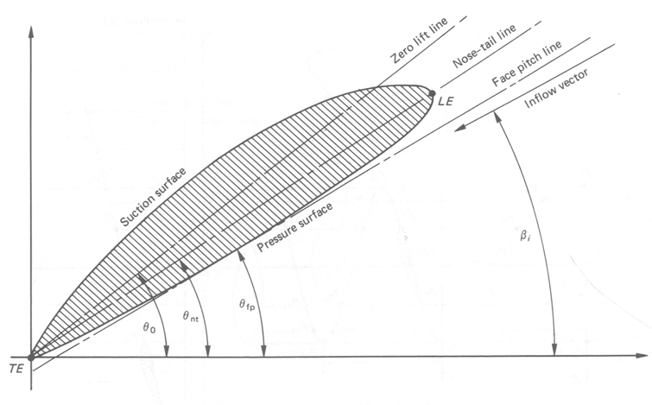
Vinkler
International Towing Tank Committee (ITTC)
Technical University of Denmark

Slide 6
Hastigheds Trekant for Mølle Rotor
φ₁
w
V_{rel}
V_{o}
V_{o}-w_{ax}
F_{tan}
φ
Rotorplan
Ωr
w_{t}
φ
L
F_{ax}
Technical University of Denmark

Slide 7
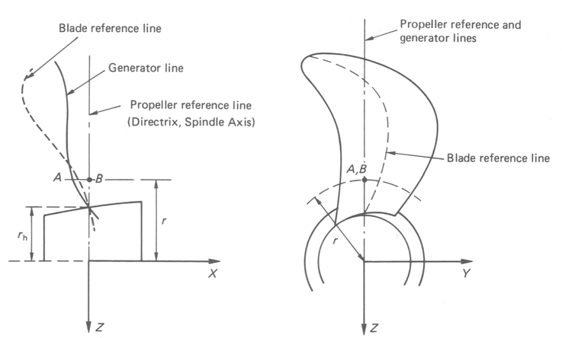
Reference Linje i Propeller Blad
International Towing Tank Committee (ITTC)
Technical University of Denmark

Slide 8
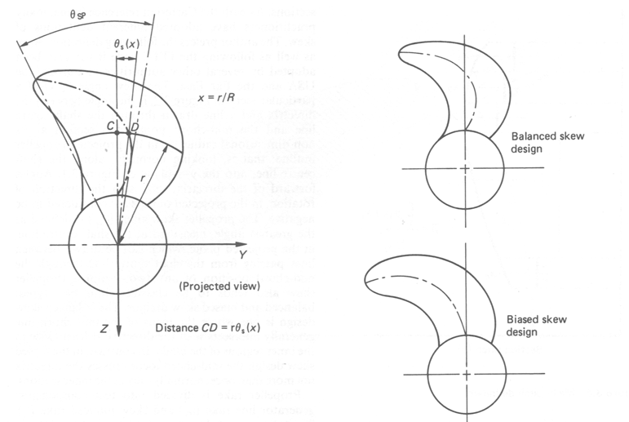
Skew Propeller
International Towing Tank Committee (ITTC)
Technical University of Denmark

Slide 9
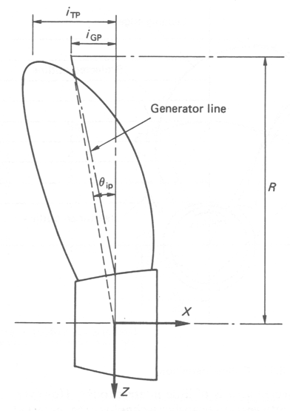
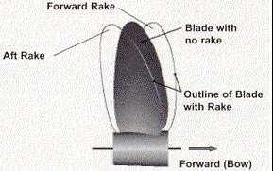
Rake - Koning
International Towing Tank Committee (ITTC)
Technical University of Denmark

Slide 10
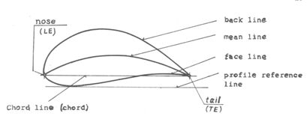
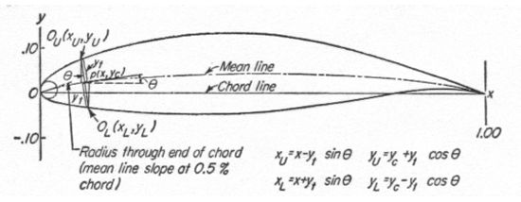
Profiler
Udvalgte profiler
NACA
RAF
Eppler
Wortmann
(svævefly)
Technical University of Denmark

Slide 11
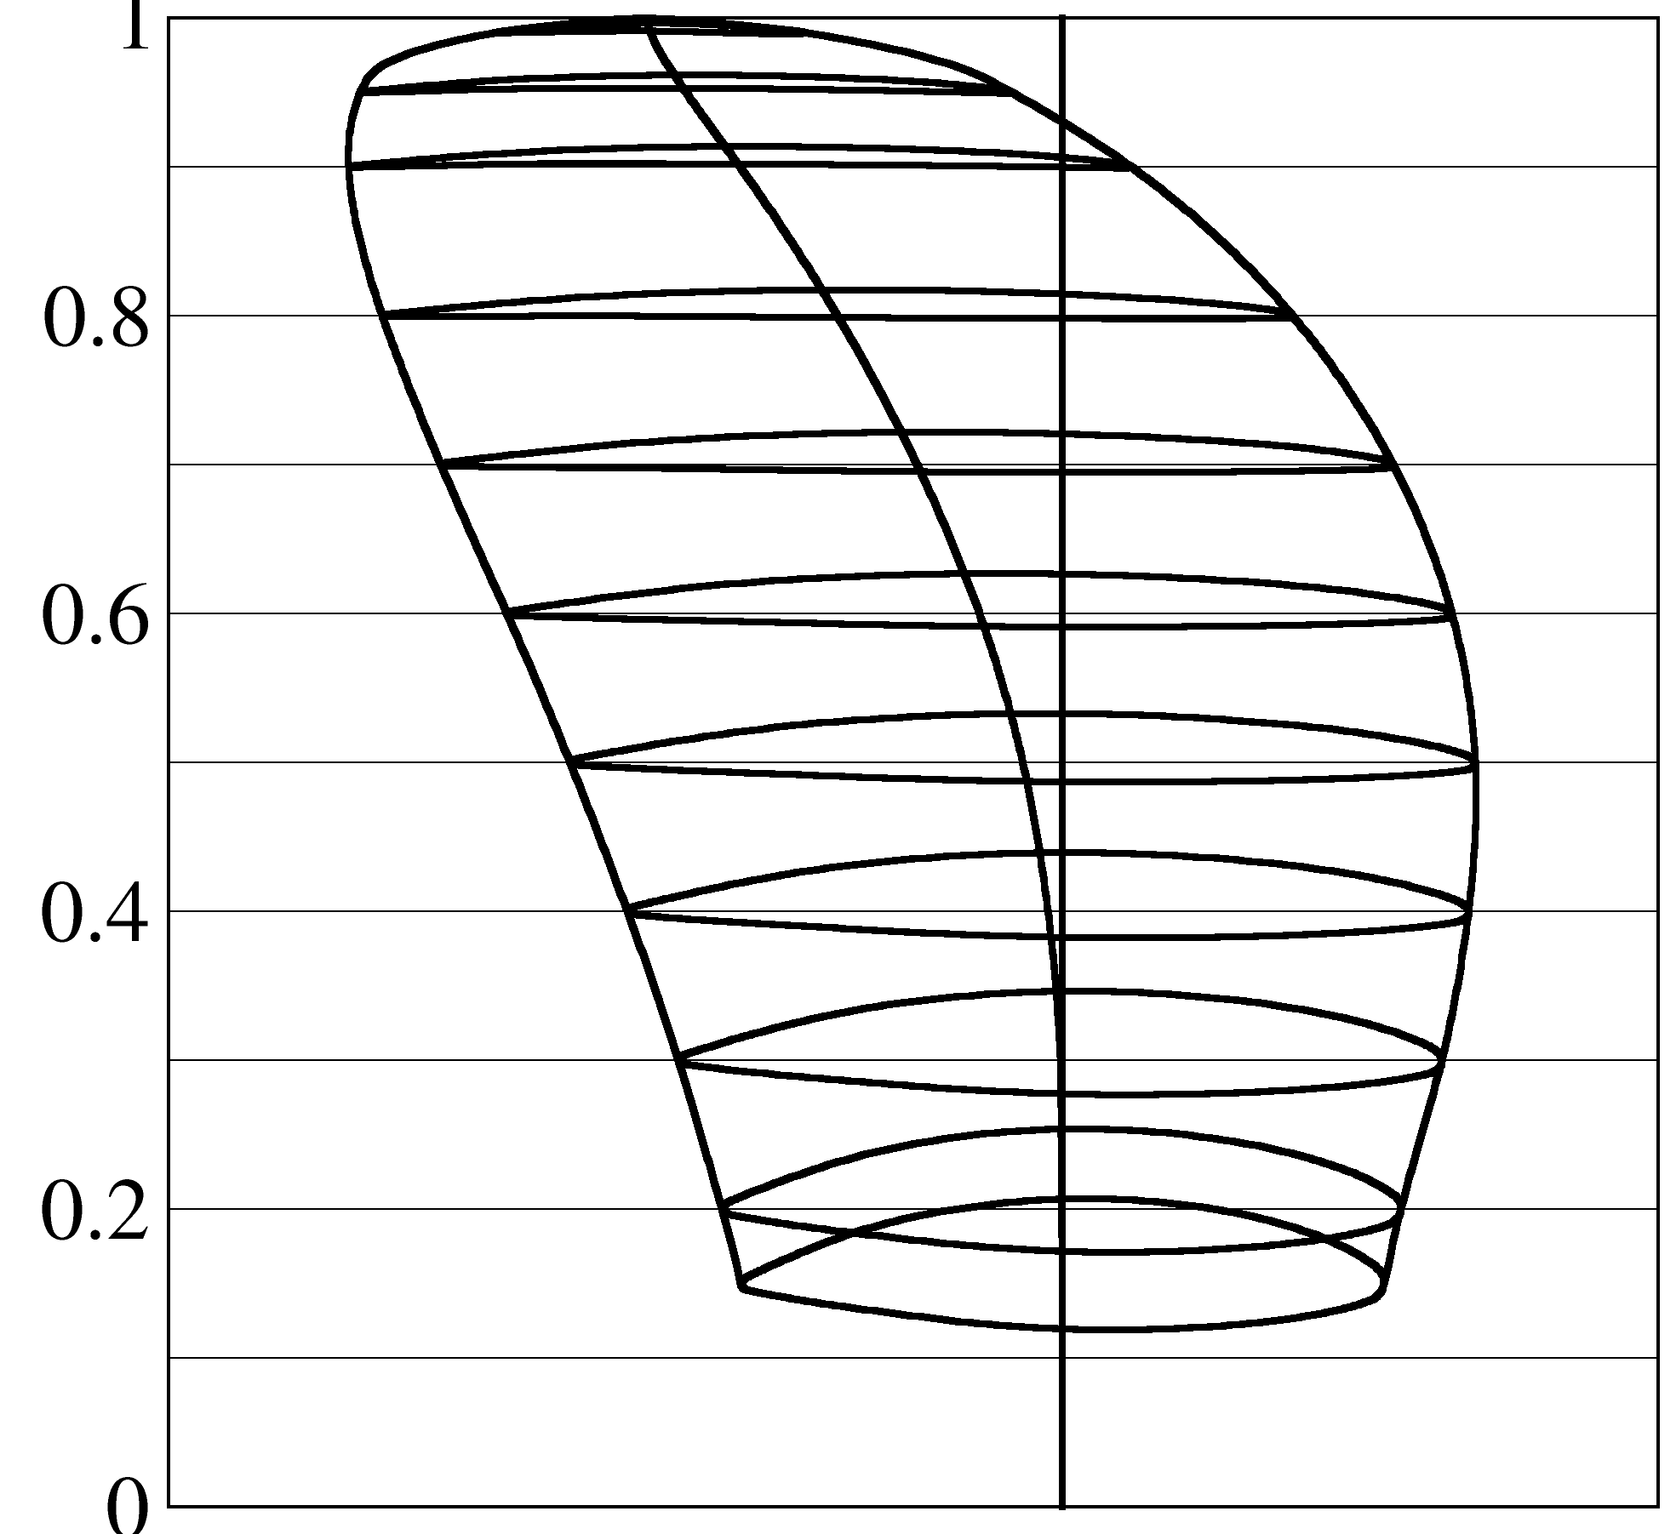
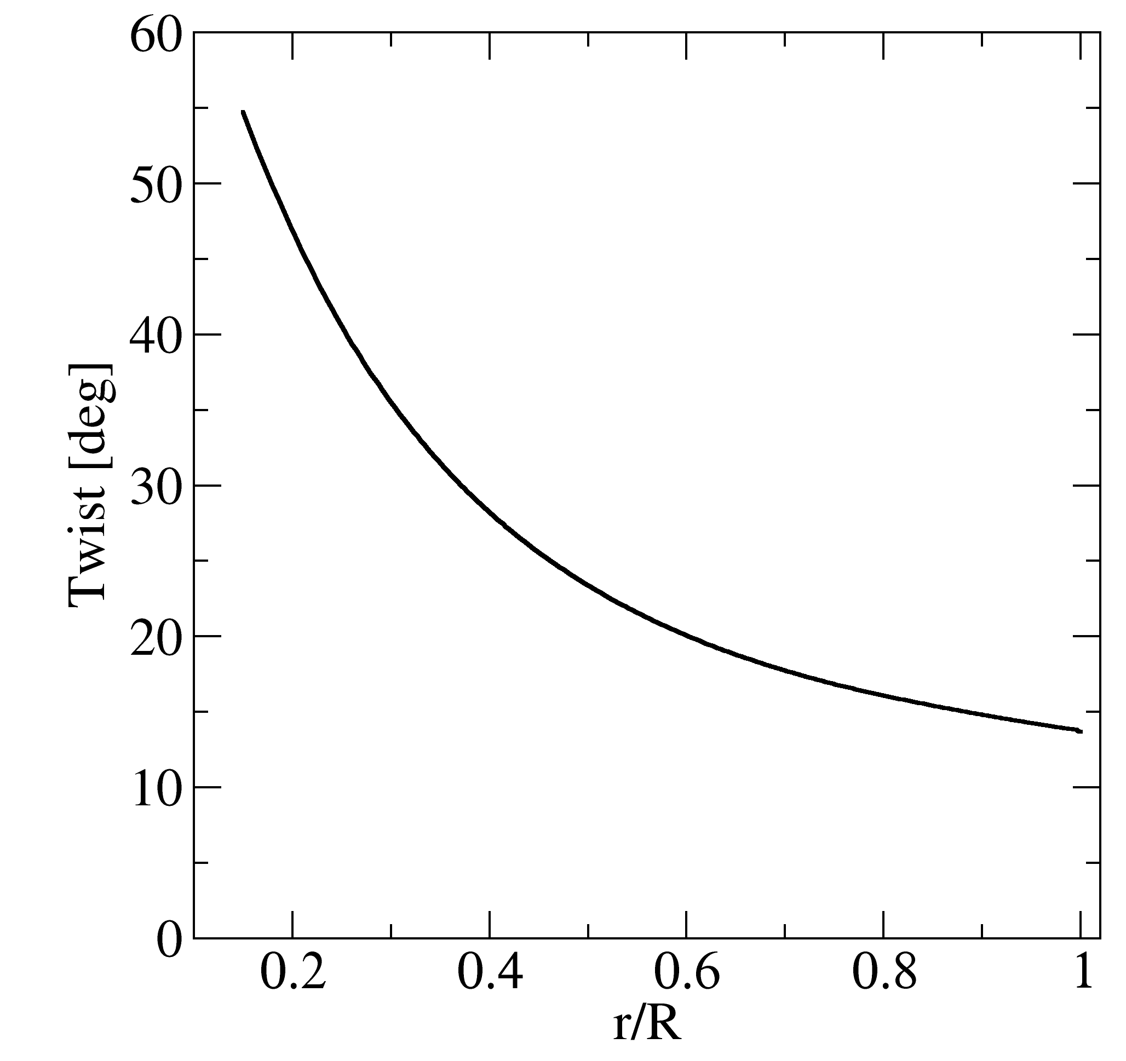
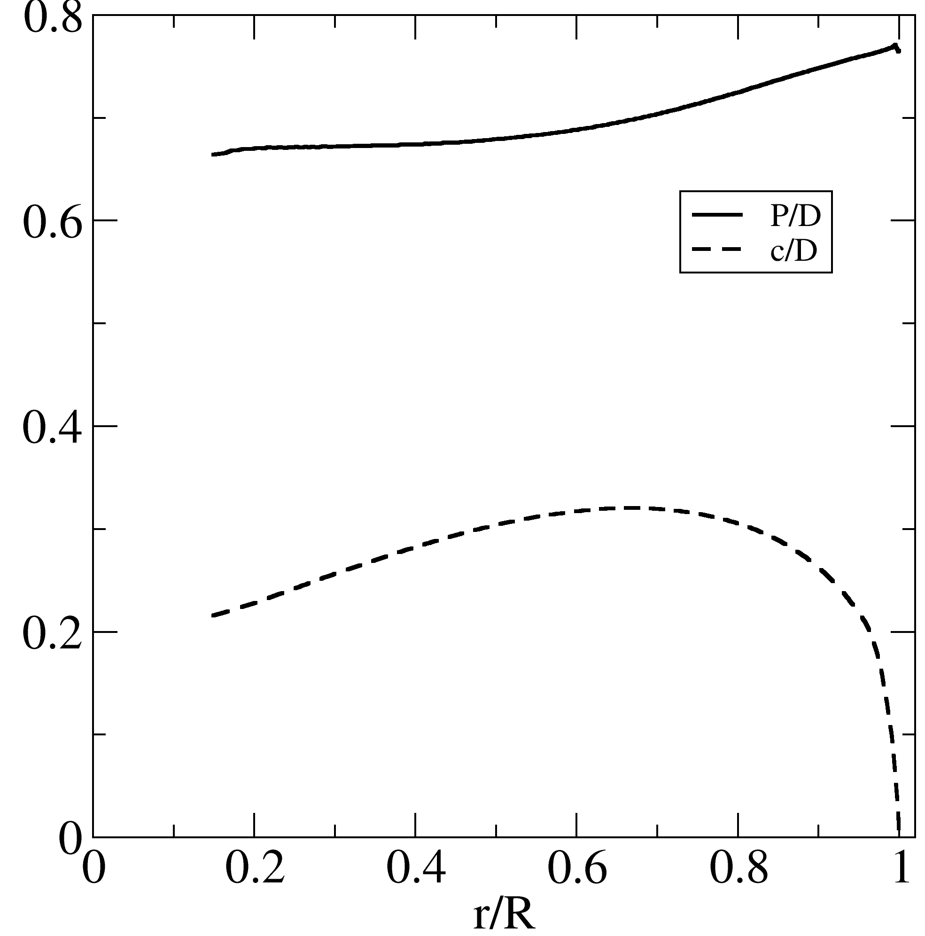
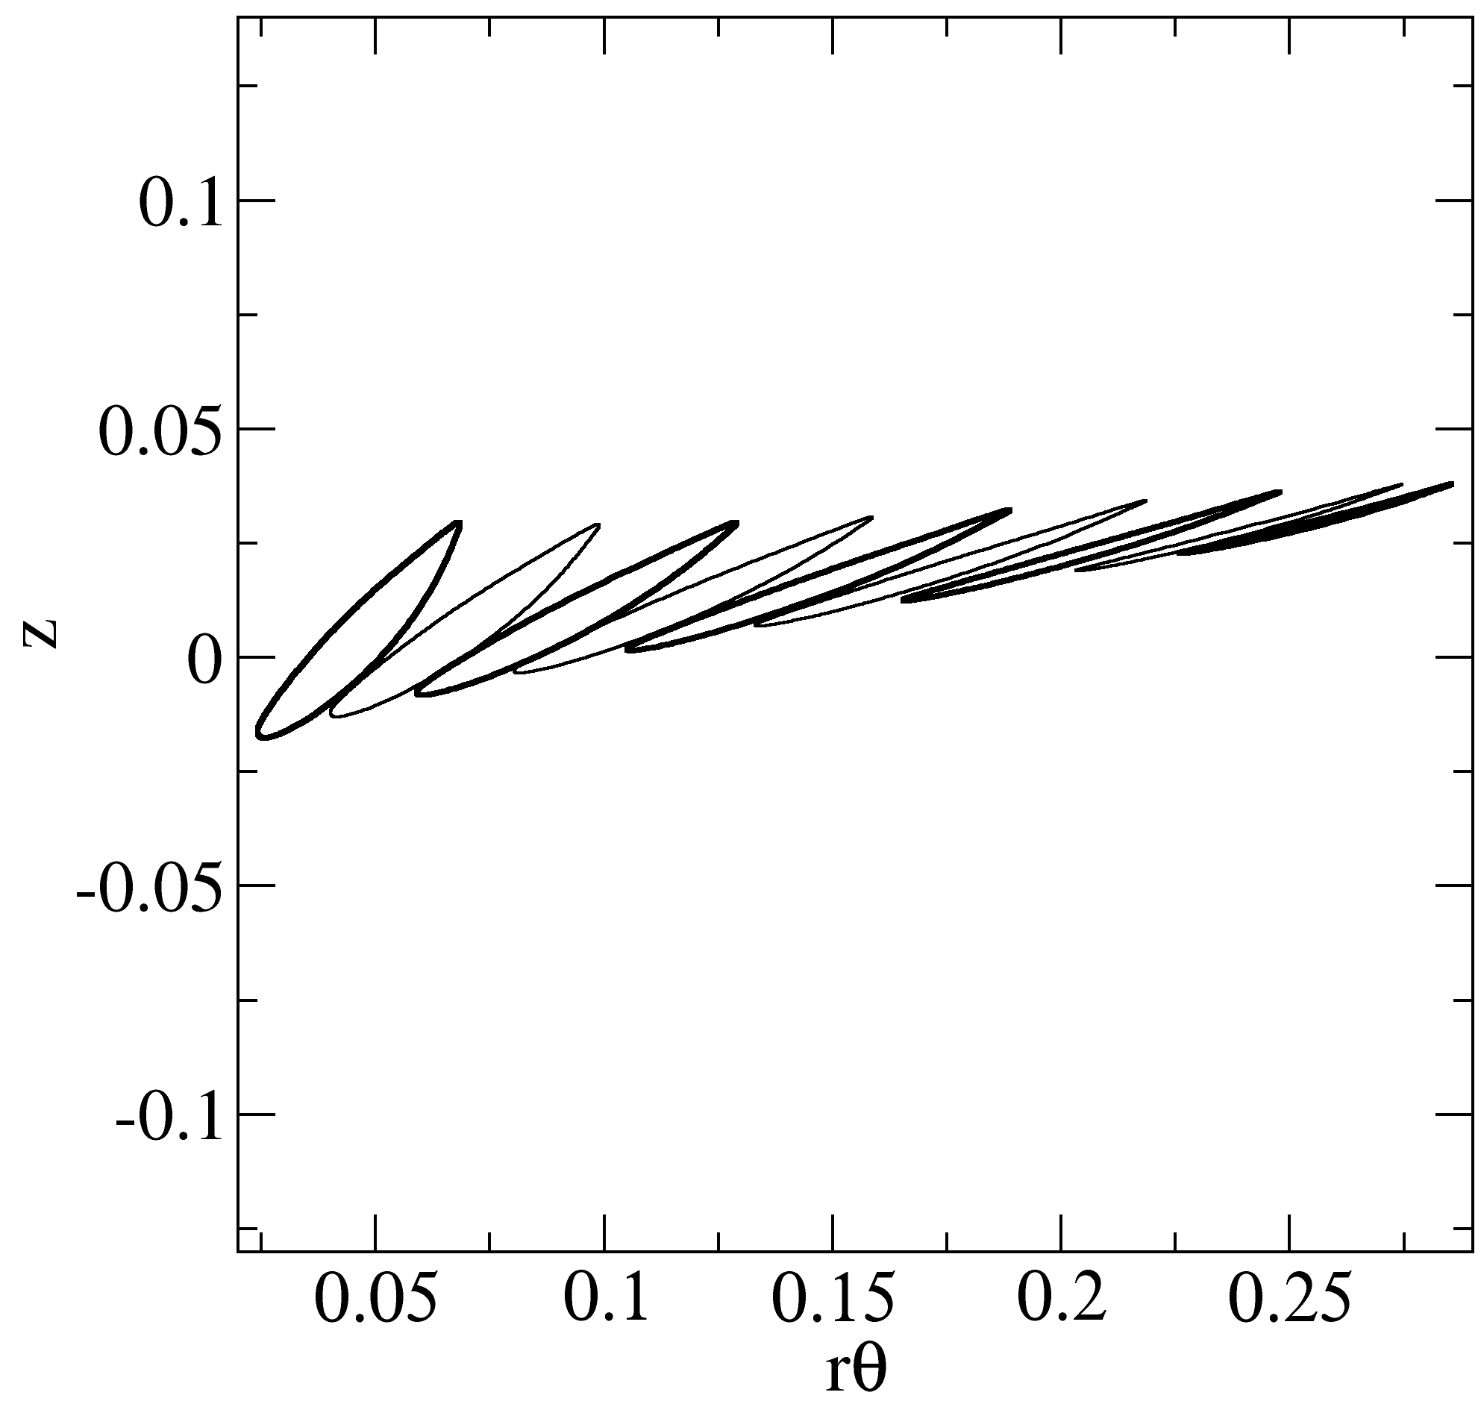
Conventionel propeller
Technical University of Denmark

Slide 12
LM 19m vindmølle vinge
Technical University of Denmark

Slide 13
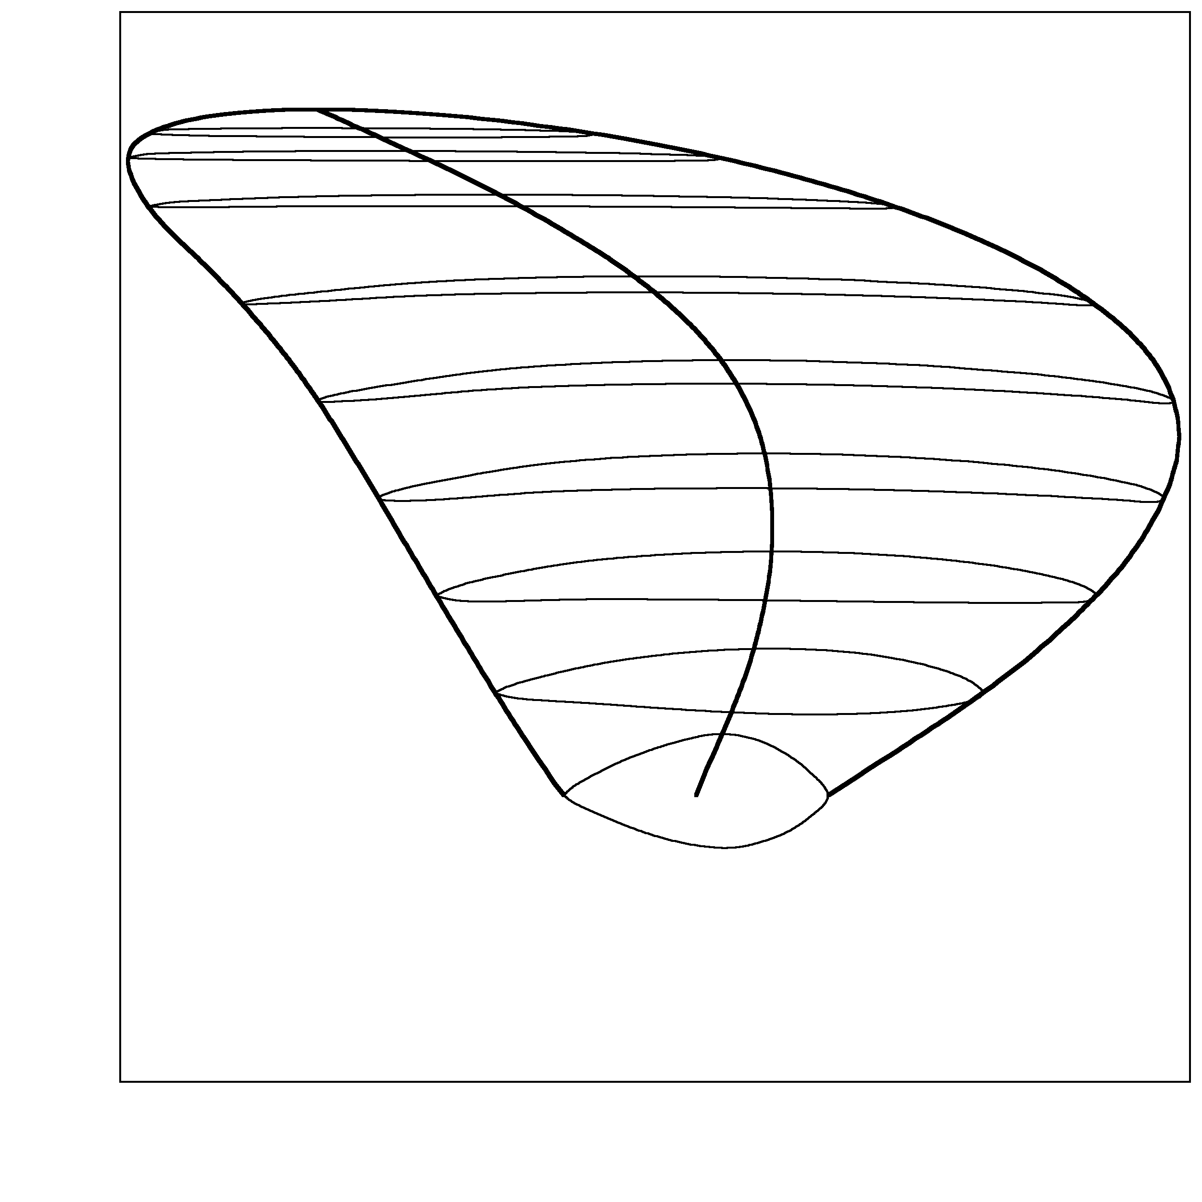
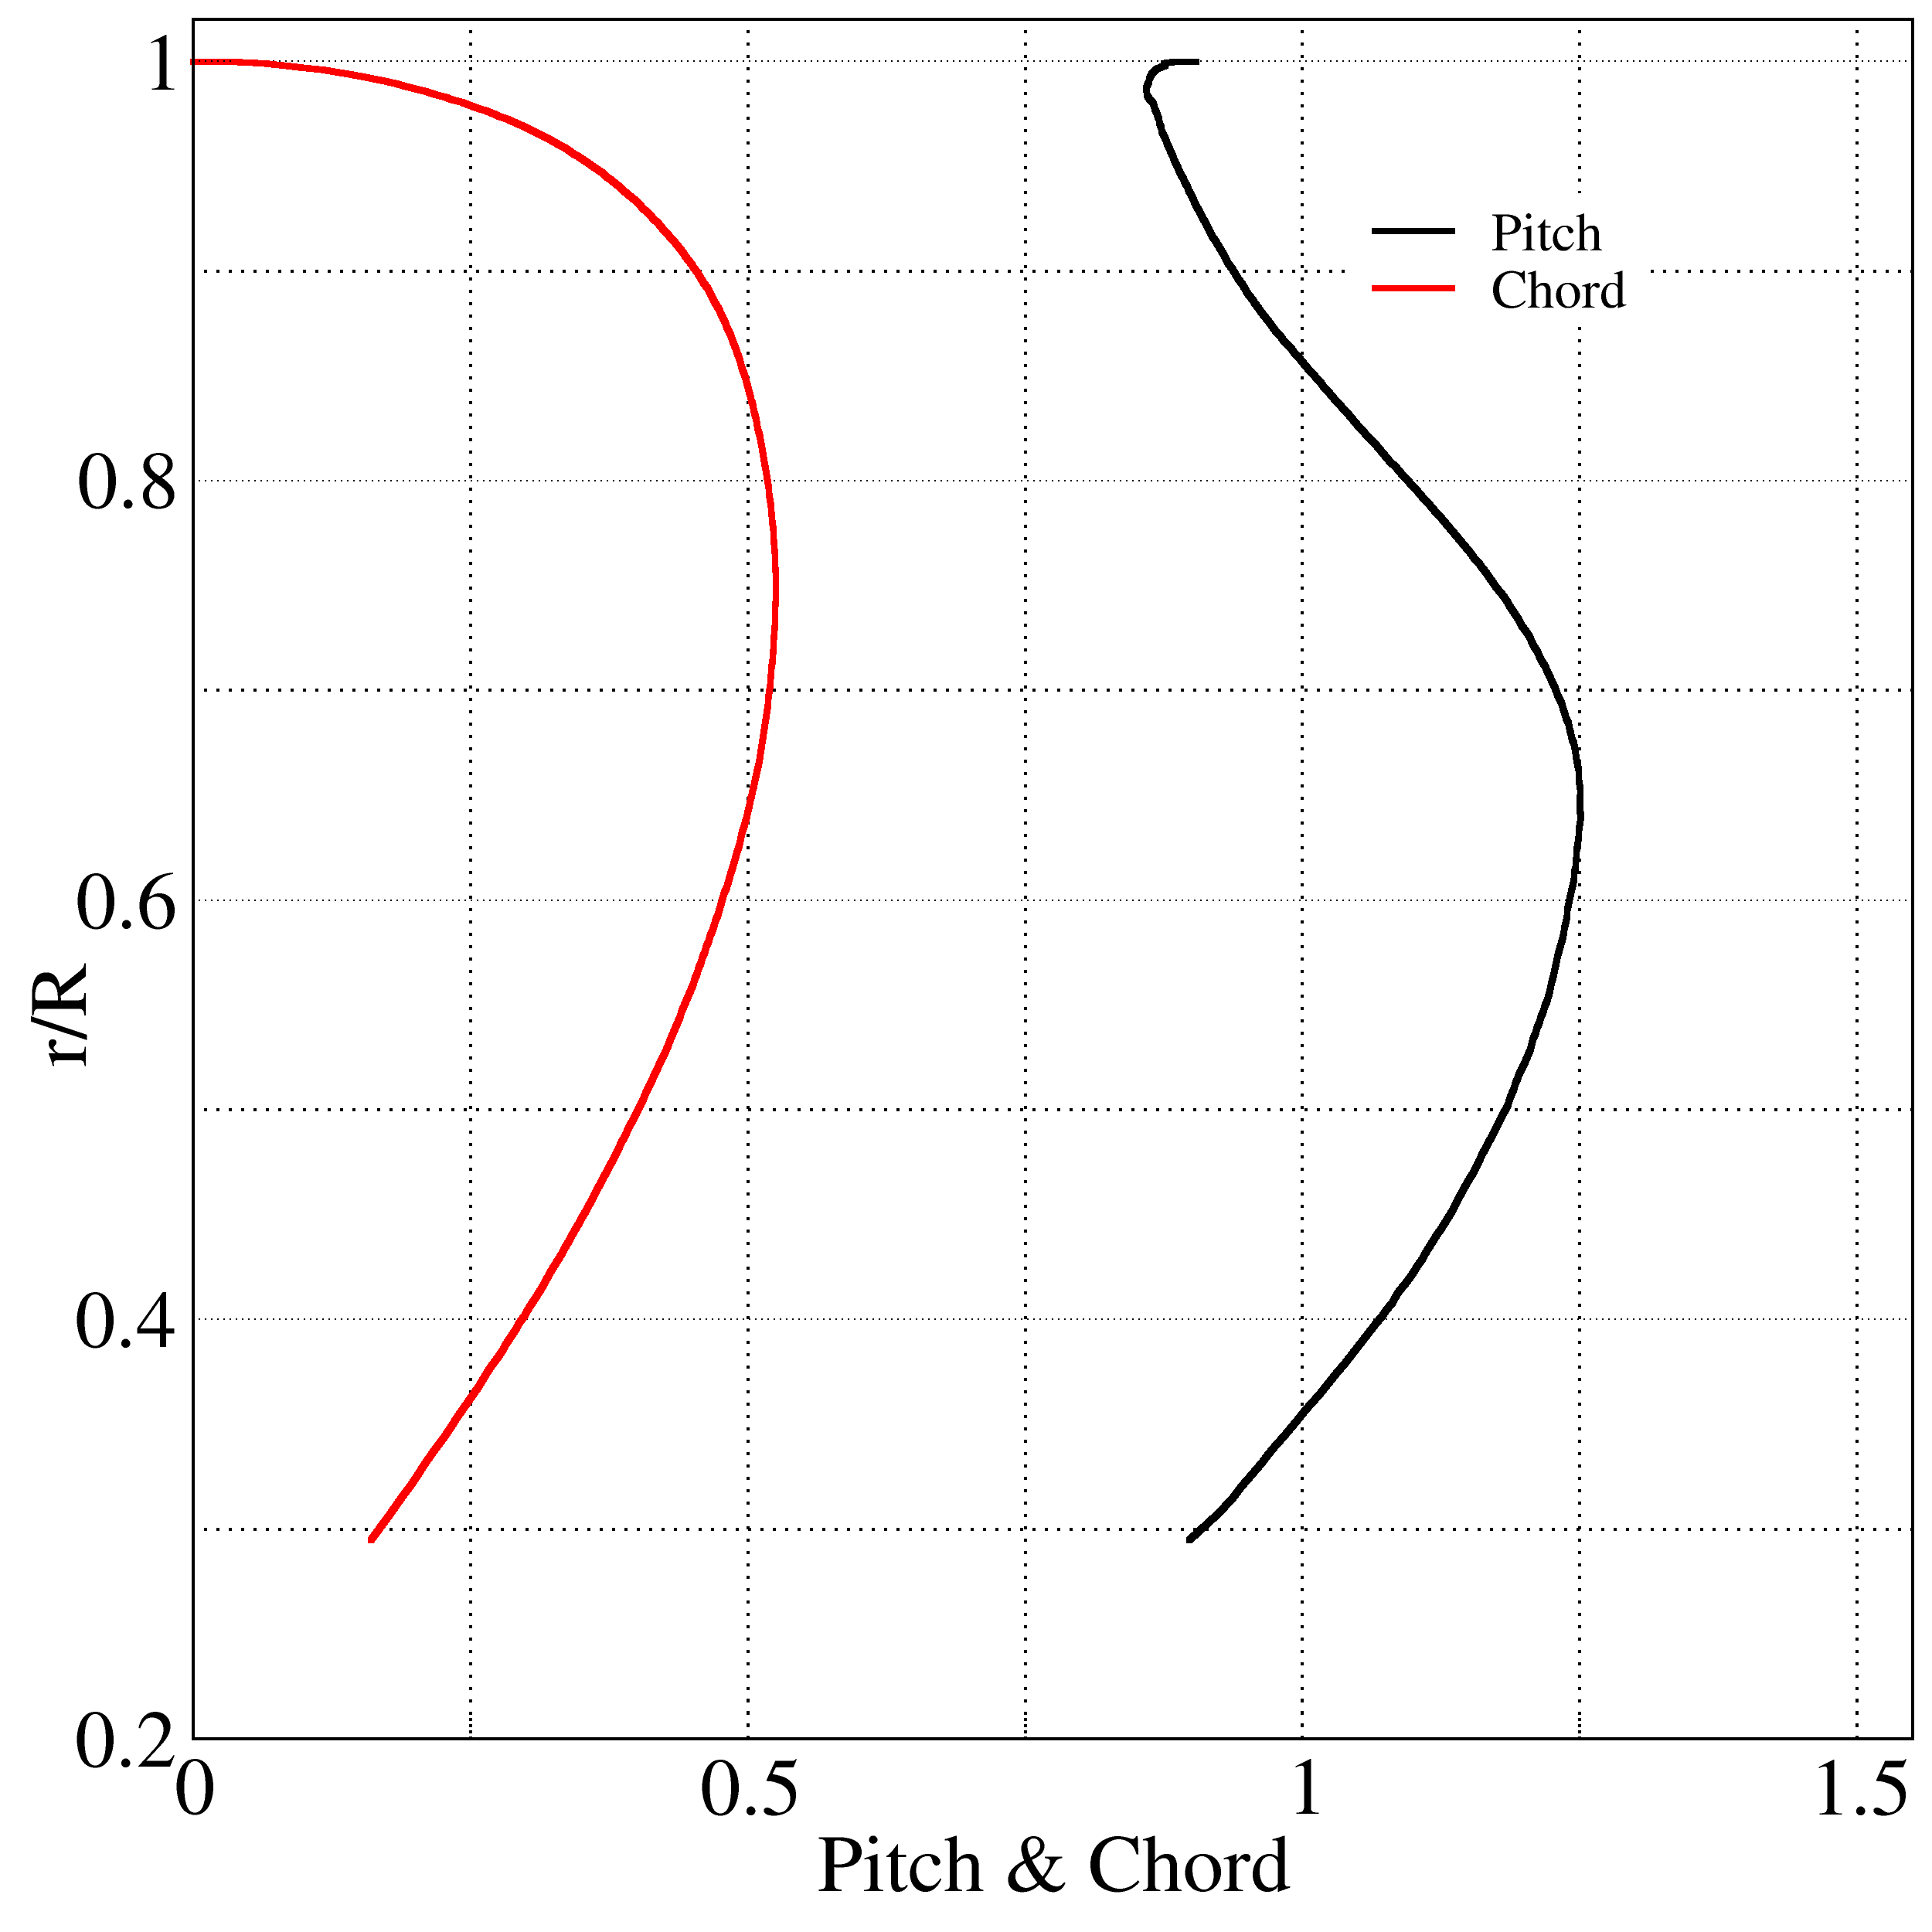
High skew propeller
Technical University of Denmark

Slide 14
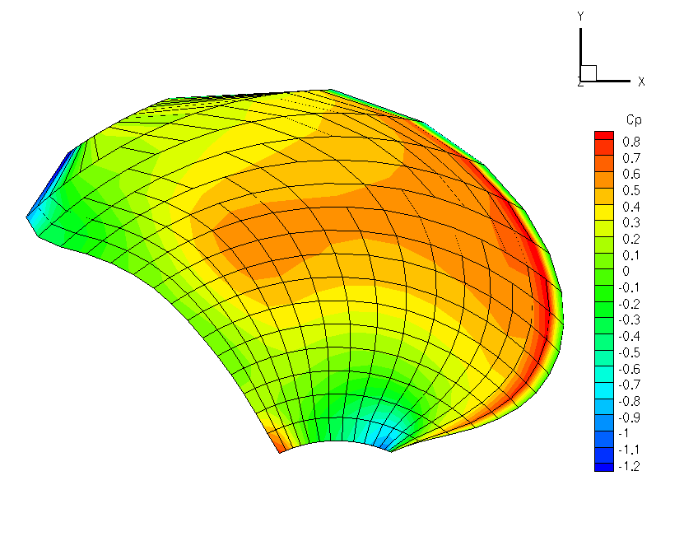
High skew propeller
Technical University of Denmark

Slide 15
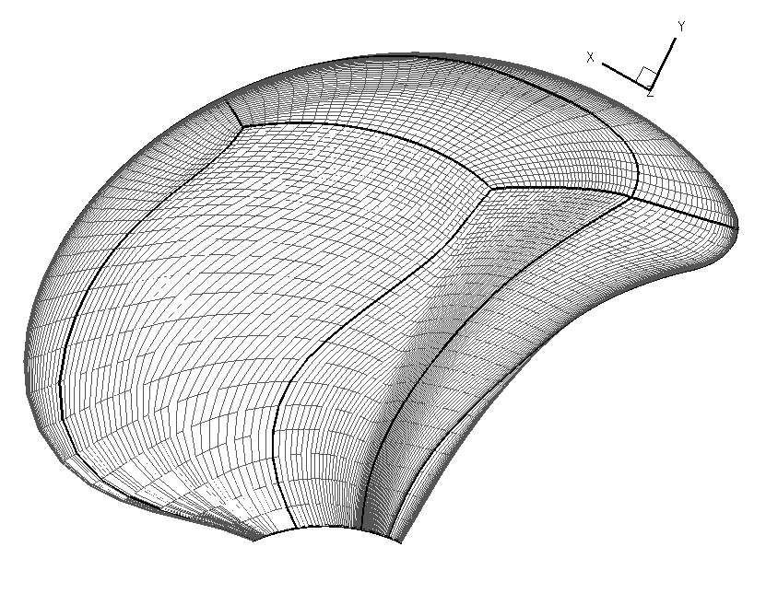
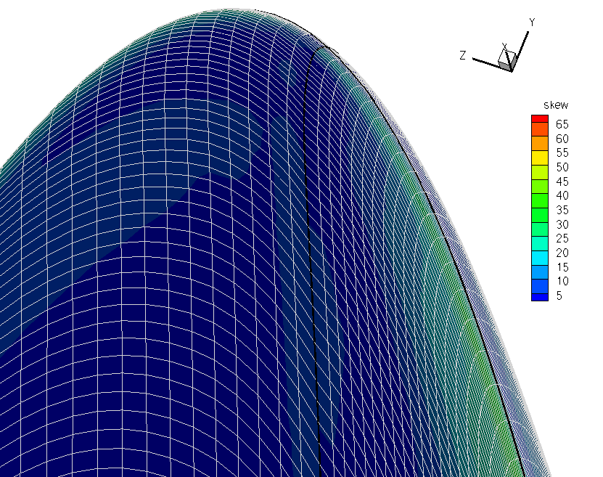
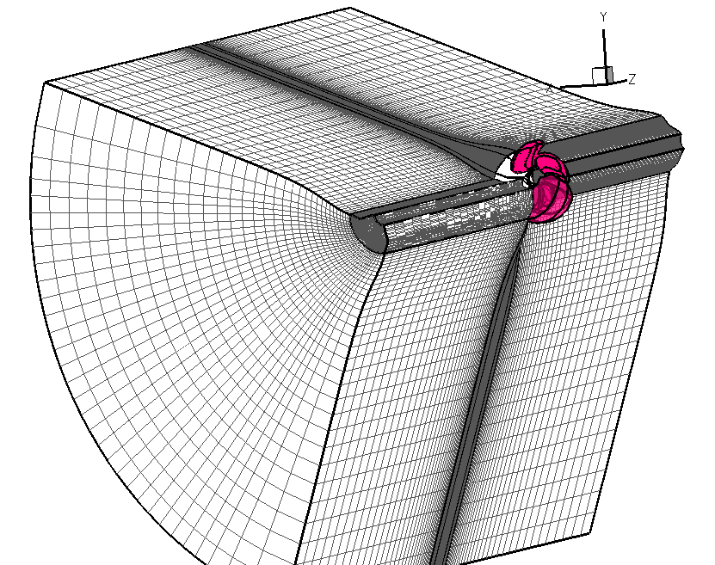
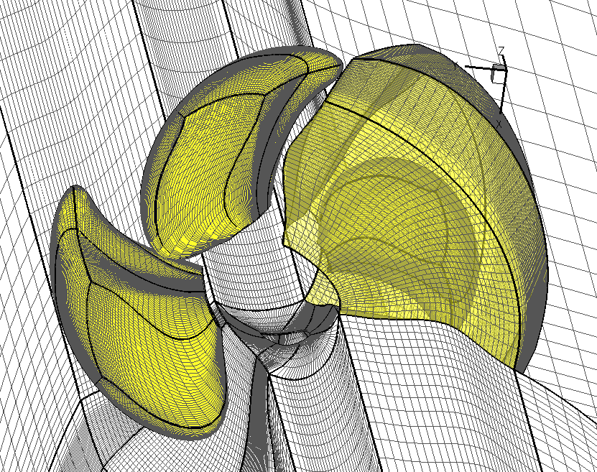
CFD på High skew propeller
Technical University of Denmark

Slide 16
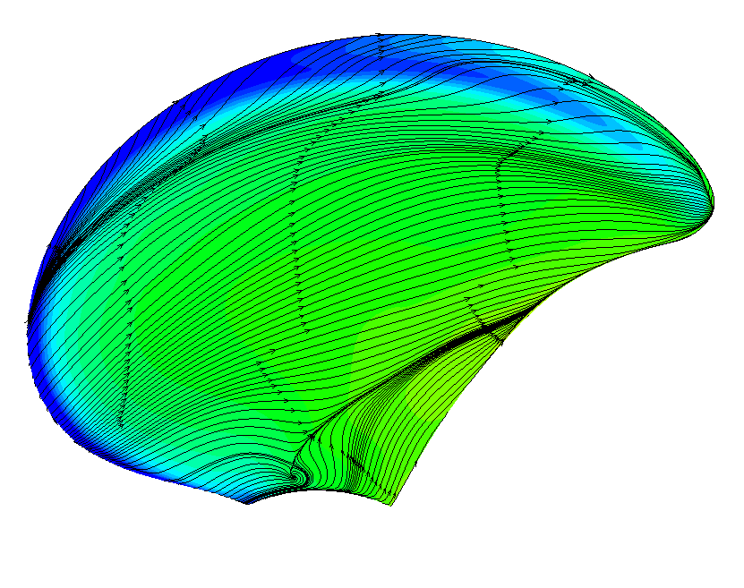
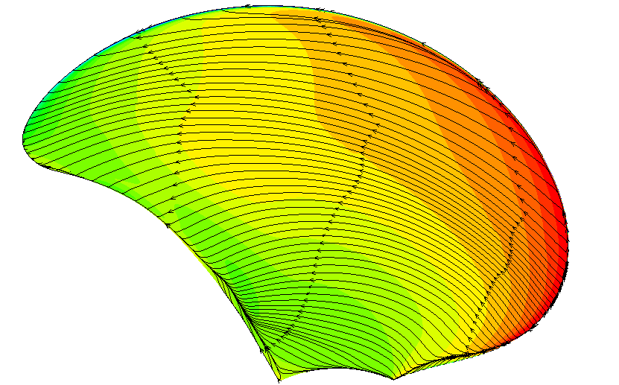
CFD på High skew propeller
Technical University of Denmark

Slide 17
Opgave - High skew propeller
Generer propeller overflade
Data: highskewlay.dat, highskewprofiles.dat
Highskewlay.dat
r/R pitch chord Skew rake bagkant forkant
2.9466e-001 1.7957e+000 1.6044e-001 0.000e+000 0.0000e+000 -1.6044e-001 1.6044e-001
3.1670e-001 1.8741e+000 1.9025e-001 7.0776e-003 -1.5315e-002 -1.8317e-001 1.9733e-001
3.3874e-001 1.9355e+000 2.1918e-001 1.5189e-002 -2.8642e-002 -2.0399e-001 2.3437e-001
. . . . . .
. . . . . .
. . . . . .
Highskewprofiles.dat
xp(1) yp(1) xp(2) yp(2) xp(3) yp(3) .......
1.00000000E+00 6.65346802E-17 1.00000000E+00 0.00000000E+00 1.00000000E+00 …….
9.99944068E-01 1.52207242E-04 9.99939286E-01 1.44388281E-04 9.99925098E-01 …….
9.99861592E-01 3.43726187E-04 9.99847067E-01 3.22631039E-04 9.99813139E-01 …….
. . . . . .
. . . . . .
. . . . . .
Technical University of Denmark

